Slide 1
How much for the carbon in the air? Understanding a Biogeochemical Cycle by Developing a Business Plan to Sequester Carbon
David R. Bowne, Ph.D.
Associate Professor
Elizabethtown College
Department of Biology
Elizabethtown, PA, USA
bowned@etown.edu

Slide 2
Student Learning Outcomes
Demonstrate understanding of the global carbon cycle
Propose a marketable product that sequesters carbon
Evaluate proposed methods of carbon sequestration
Demonstrate understanding of externalities
Demonstrate understanding of the relationship between carbon dioxide and global climate change

Slide 3
A two-prong approach:
Fictional Narrative: Engage the students, prompt discussion, and increase comprehension of the carbon cycle and climate change.
Creative Activity: Apply scientific understanding of the carbon cycle by developing a carbon sequestration business plan.

Slide 4
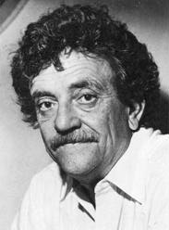
Slaughterhouse-five Kurt Vonnegut
www.vonnegut.com
“You know what I say to people when I hear they’re writing anti-war books?”
“No. What do you say, Harrison Starr?”
“I say, ‘Why don’t you write an anti-glacier book instead?”
What he meant, of course, was that there would always be wars, that they were as easy to stop as glaciers. I believe that, too.

Slide 5
“As easy to stop as glaciers…..”

Slide 6
The story: Henry Ford Hated Glaciers*
Two mismatched roommates, Fred and Jim, argue over the causes and solutions to climate change.
Fred develops a conspiracy theory in which Henry Ford’s business activities were a secret plan to melt glaciers.
Jim, a business student, thinks Fred’s theory is idiotic but is inspired to develop his own business plan to sequester carbon.
*An original work by D.R. Bowne, available upon request

Slide 7
“…..No, if Ford was intent on getting rid of glaciers, he’d be more subtle.”
“Or more interested in making cars than wasting his time on this crap.”
“No, man. You’re missing the point.” Fred moved to the window, gesturing towards it, as if imploring his roommate to view deeply the world outside. “Ford did both, but only one was obvious. His manufacturing techniques completely revolutionized the world. Ford made cars and other goods affordable for the common man, but he didn’t do it for the sake of making stuff or getting rich. He did it to melt glaciers.”
“You’ve lost me, Fred.” Jim said.
Now it was Fred’s turn to speak slowly, if not softly. “It’s simple. Carbon dioxide gets emitted from car exhaust, from the manufacturing process, from massive deforestation to obtain rubber to make tires. Every step puts CO₂ into the air and enhances the greenhouse effect, every step raises the planet’s temperature, every step melts glaciers. Don’t you see? Vonnegut was wrong, stopping glaciers is easy. We don’t need an anti-glacier book, we’re living it.”
Excerpt from “Henry Ford Hated Glaciers,” Bowne

Slide 8
Jim’s idea
[CO₂]_{atm}
[CO₂]_{water}
Clam shell
Concrete (tabby)
Sell Clams
Sell Concrete

Slide 9
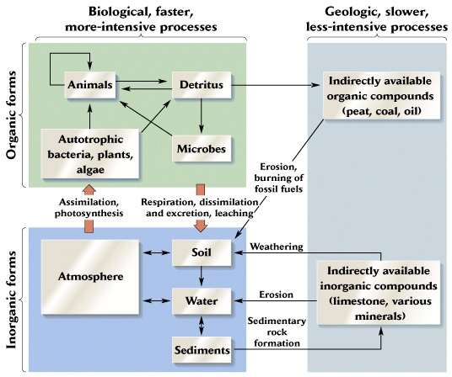
Figure 7.3 Ricklef’s The Economy of Nature, 5th ed

Slide 10
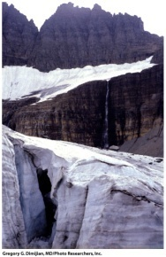
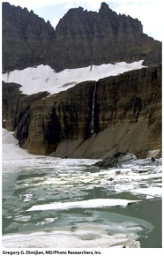
Glaciers are melting
Example of
Global climate change
Ford conspiracy
HOW & WHY?
Primary Driver: increase atm [CO₂ ]
Negative externality
Greenhouse effect (enhanced)
Explain
Carbon cycle
Solution?
Reduce atm [CO₂ ]
Student ideas
Increase carbon sequestration
Reduce emissions (Fred’s approach)
Jim’s idea

Slide 11
Ecology Meets Entrepreneurship
Your assignment is to come up with a product that sequesters carbon AND is marketable. You and your team (4 people per team) will pitch your idea to the class of potential investors, in a faux “Shark Tank” (http://abc.go.com/shows/shark-tank) format.
Assignment: (50 points total)
1. Each team of entrepreneurs will turn in a two page business plan. This document will briefly summarize the product, how the product will sequester carbon (the scientific basis must be sound and include for how long, in general, the carbon will be stored), and identify the target audience for purchasing the product. All facts and figures must be cited. (20 points)
. Each team will pitch their idea in a 10 minute presentation. Use whatever visual aids are necessary to make your pitch most appealing. You will have 10 minutes for both the pitch and question/answer period. (20 points)
. Everyone (each individual student) will hand in a critique (one page maximum) of your favorite product (it cannot be your own one). Which one would most likely get your investment dollars? Tell me what you like about the product, explain the basic science of the product, and if the product is likely to have a net positive impact on reducing atmospheric carbon dioxide. (10 points)

Slide 12
And ecology , creativity, and entrepreneurship lived happily ever after.
The End.

